Slide 1
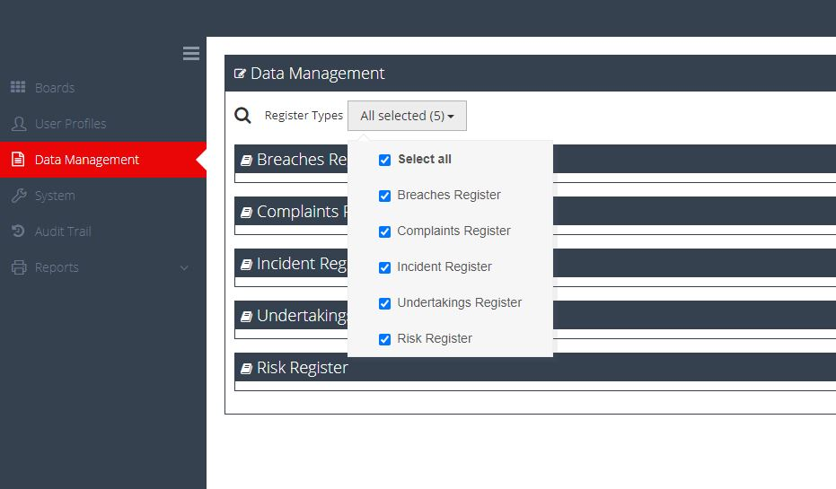
Five different registers now available – more can be added

Slide 2
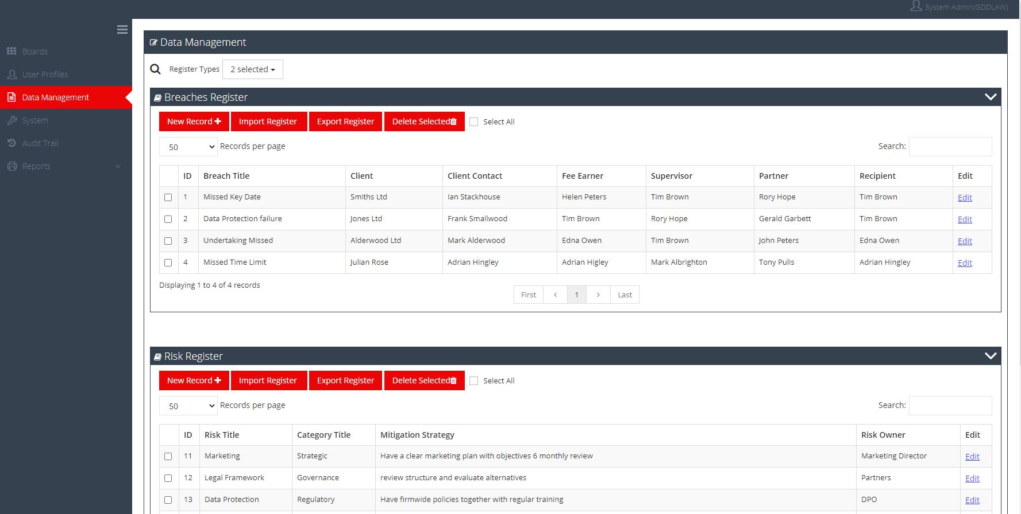
Look at your data – by entry by register

Slide 3
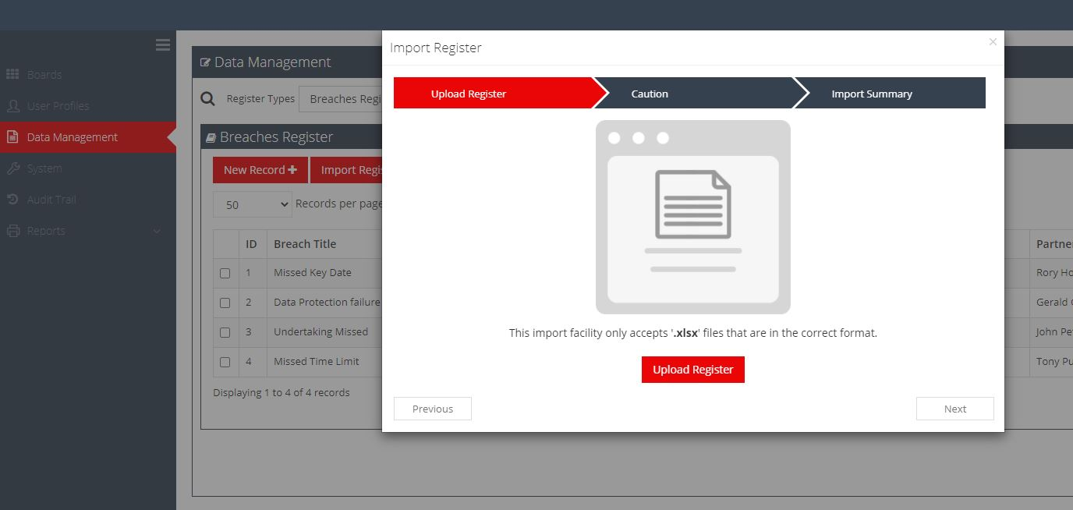
Add more data

Slide 4
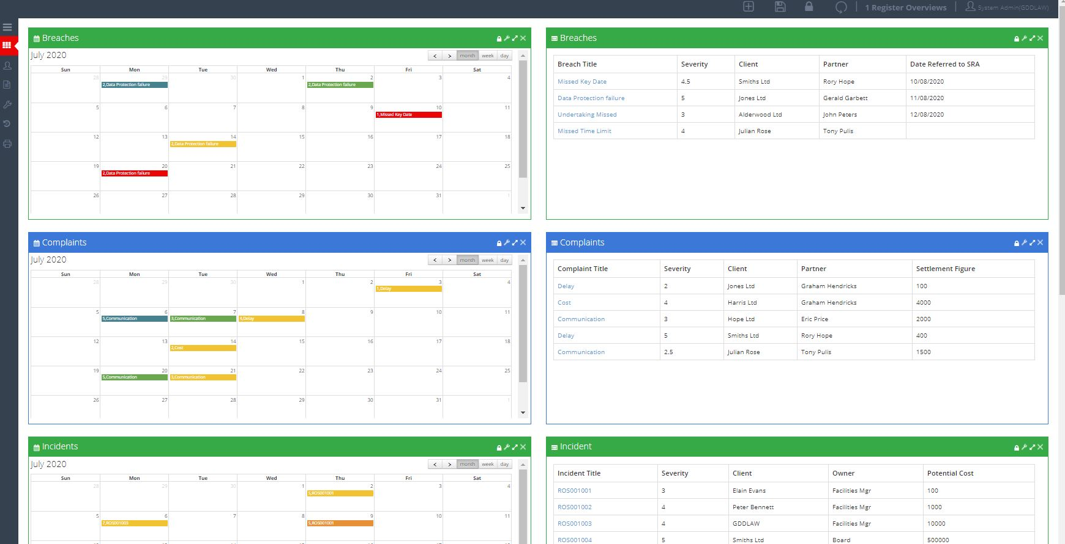
Look at a complete overview

Slide 5
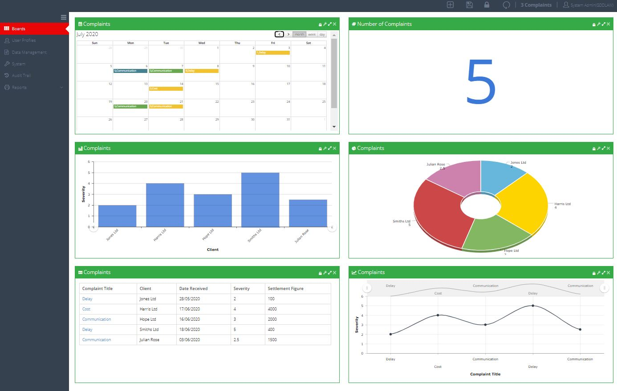
Or the details on a single register – you choose

Slide 6
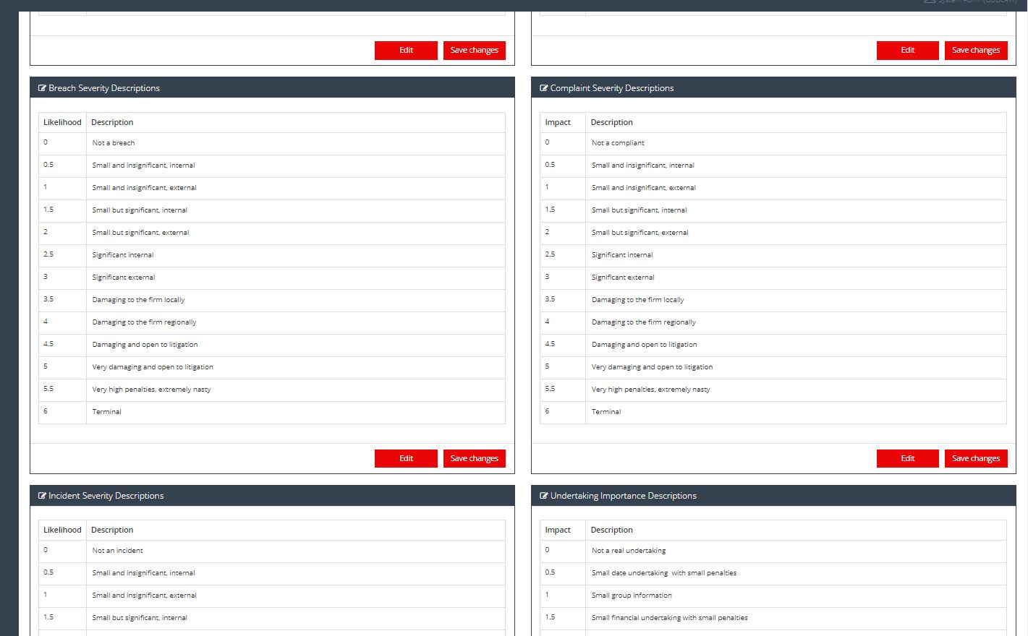
Configure the system the way you want it

Slide 7
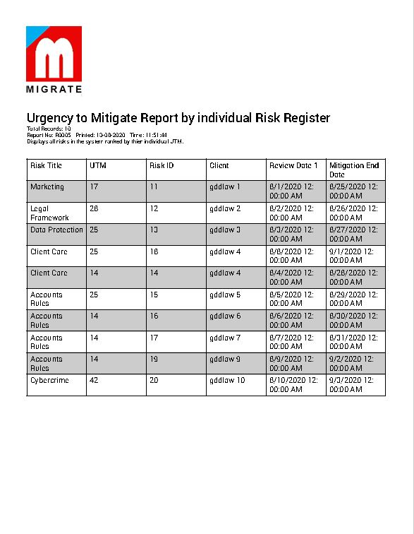
Run your reports

